Slide 1
Diagrams

Slide 2
From img_gen_cartoons.m
overview
natural
scintigram
radiograph

Slide 3
From img_gen_cartoons.m
scene
Add light source icon and rays
Add xray source icon and rays that go through
natural
radiograph
scintigram
image plane

Slide 4
EMFs

Slide 5
spectra: heatmaps and dotplots

Slide 6


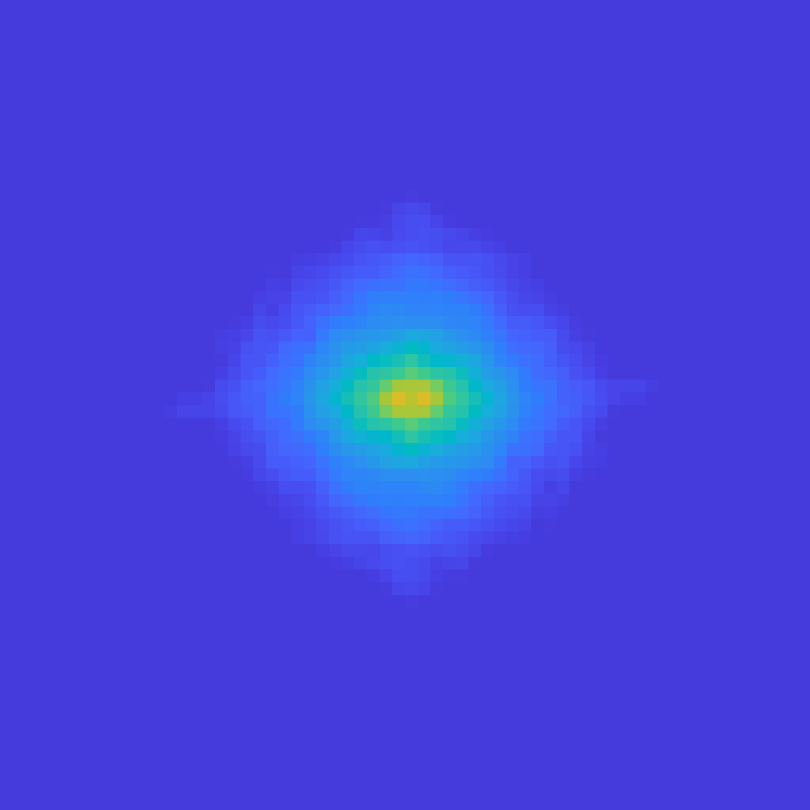
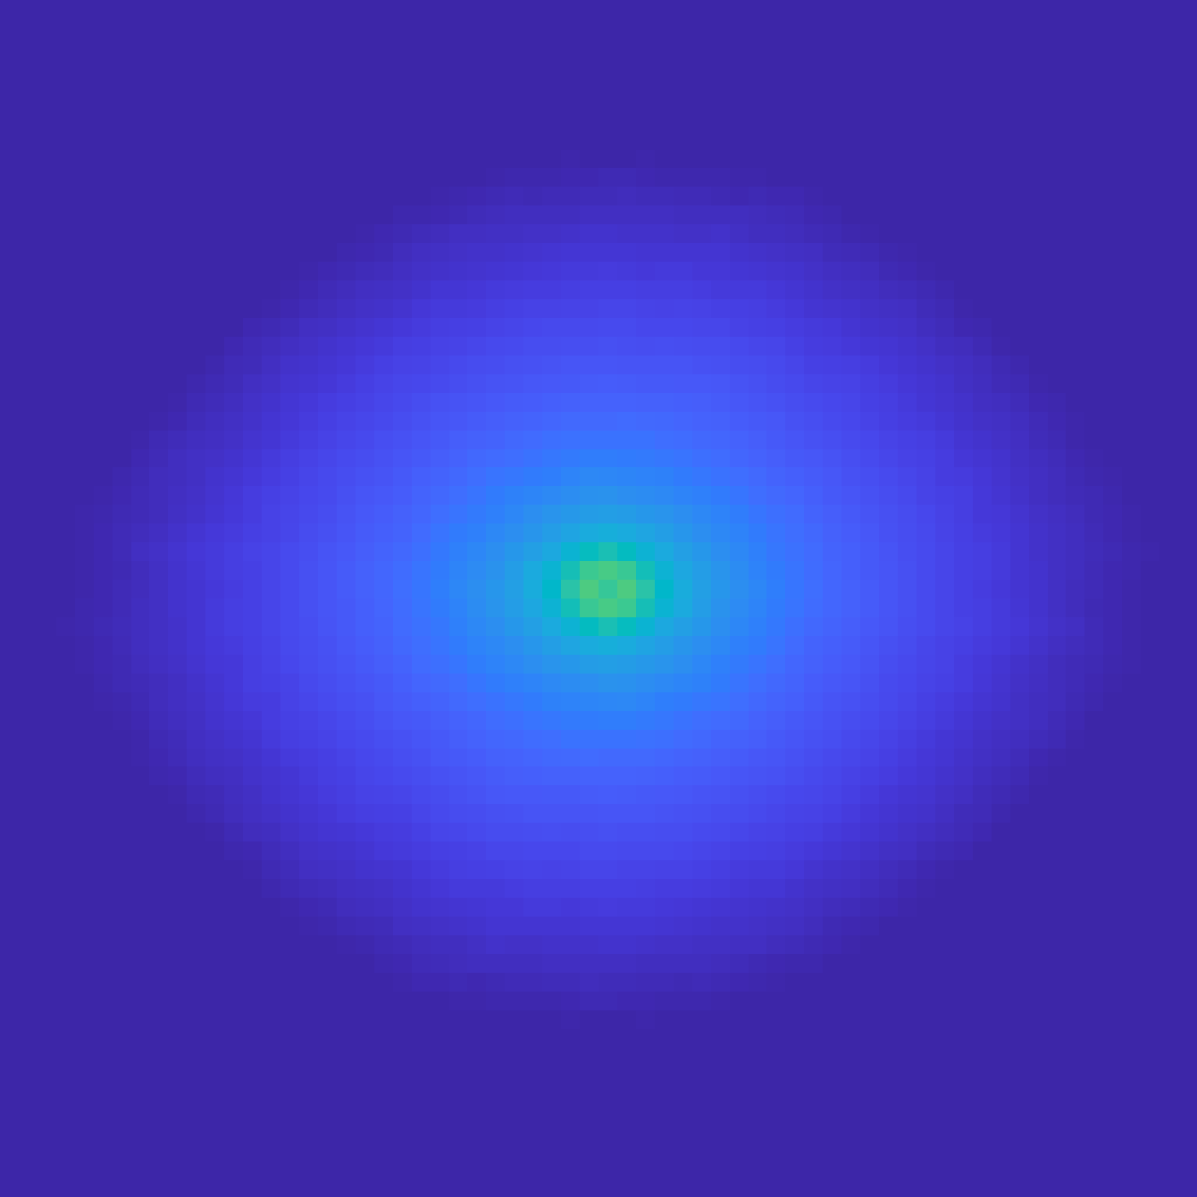
bone
bone interior
scint
std (avg per subj)
Natural images
0.25
2.5
0.25
std (avg per subj)
2.5
0.25
std (avg per subj)
2.5
0.25
std (avg per subj)
-2.5
2
2
2
-3
1.5
1.5
1.5
-3.5
1
1
1
-4
l
0.5
l
0.5
l
0.5
l
-4.5
e
e
e
e
x
x
x
x
i
i
i
i
p
p
p
p
r
0
r
0
r
0
r
-5
e
e
e
e
p
0
p
0
p
0
p
0
s
s
s
s
e
e
e
e
l
-0.5
l
-0.5
l
-0.5
l
-5.5
c
c
c
c
y
y
y
y
c
-1
c
-1
c
-1
c
-6
-1.5
-1.5
-1.5
-6.5
-2
-2
-2
-7
-2.5
-2.5
-2.5
-7.5
-0.25
0
0.25
-3
-0.25
-3
-0.25
-3
-0.25
-8
cycles per pixel
-0.25
0
0.25
-0.25
0
0.25
-0.25
0
0.25
std (N=2 R=64)
std (N=2 R=64)
cycles per pixel
std (N=2 R=64)
cycles per pixel
std (N=2 R=64)
cycles per pixel
bonedatabase pad=1 whiten=per view (subj wtd) marg=1 pxlmean 0 roimean 1 cosbell 1 gen
bonedatabasesubroi pad=1 whiten=per view (subj wtd) marg=1 pxlmean 0 roimean 1 cosbell 1 gen
scindatabase pad=1 whiten=per view (subj wtd) marg=1 pxlmean 0 roimean 1 cosbell 1 gen
Penn Natural Images log NRorig=[16 32] pad=1 whiten=per view (subj wtd) marg=1 pxlmean 0 roimean 1 cosbell 1 gen
all
diag oppsign
10
2
diag samesign
2
vert
10
horiz
10
1
all
10
1
diag oppsign
diag samesign
vert
horiz
r
0
e
10
r
10
0
w
e
o
w
p
o
p
10
-1
10
-1
10
-2
10
-2
10
-3
-2
-1
10
-3
10
-2
10
-1
10
10
std (N=2 R=64)
cycles per pixel
10
-2
10
-1
std (N=2 R=64)
cycles per pixel
bonedatabasesubroi pad=1 whiten=per view (subj wtd) marg=1 pxlmean 0 roimean 1 cosbell 1 gen
cycles per pixel
bonedatabase pad=1 whiten=per view (subj wtd) marg=1 pxlmean 0 roimean 1 cosbell 1 gen

Slide 7
bone
from [bone|bonesubs|scin]_spec_n2_r64_[23|30]jan2023_[heatmap|dotplot_tweaked.emf
std (avg per subj)
0.25
2.5
2
10
2
1.5
10
1
all
1
diag oppsign
diag samesign
vert
l
0.5
horiz
e
x
i
p
r
0
e
r
10
0
p
e
s
0
w
e
o
l
-0.5
p
c
y
c
-1
10
-1
-1.5
-2
-2.5
10
-2
-0.25
0
0.25
-3
std (N=2 R=64)
cycles per pixel
10
-3
-2
-1
bonedatabase pad=1 whiten=per view (subj wtd) marg=1 pxlmean 0 roimean 1 cosbell 1 gen
10
10
std (N=2 R=64)
cycles per pixel
bonedatabase pad=1 whiten=per view (subj wtd) marg=1 pxlmean 0 roimean 1 cosbell 1 gen

Slide 8
bone interior
from [bone|bonesubs|scin]_spec_n2_r64_[23|30]jan2023_[heatmap|dotplot_tweaked.emf
0.25
std (avg per subj)
2.5
all
diag oppsign
2
10
2
diag samesign
vert
horiz
1.5
1
10
1
l
0.5
e
x
i
p
r
0
e
p
0
r
10
0
s
e
e
w
l
-0.5
o
c
p
y
c
-1
-1.5
10
-1
-2
-2.5
10
-2
-0.25
-3
-0.25
0
0.25
std (N=2 R=64)
cycles per pixel
bonedatabasesubroi pad=1 whiten=per view (subj wtd) marg=1 pxlmean 0 roimean 1 cosbell 1 gen
10
-3
10
-2
10
-1
std (N=2 R=64)
cycles per pixel
bonedatabasesubroi pad=1 whiten=per view (subj wtd) marg=1 pxlmean 0 roimean 1 cosbell 1 gen

Slide 9
scint
from [bone|bonesubs|scin]_spec_n2_r64_[23|30]jan2023_[heatmap|dotplot_tweaked.emf
0.25
std (avg per subj)
2.5
10
2
all
diag oppsign
2
diag samesign
vert
horiz
1.5
1
10
1
l
0.5
e
x
i
p
r
0
r
10
0
e
e
p
0
w
s
o
e
p
l
-0.5
c
y
c
-1
10
-1
-1.5
-2
-2.5
10
-2
-0.25
-3
-0.25
0
0.25
std (N=2 R=64)
cycles per pixel
10
-3
10
-2
10
-1
scindatabase pad=1 whiten=per view (subj wtd) marg=1 pxlmean 0 roimean 1 cosbell 1 gen
std (N=2 R=64)
cycles per pixel
scindatabase pad=1 whiten=per view (subj wtd) marg=1 pxlmean 0 roimean 1 cosbell 1 gen

Slide 10
from nimg_spec_n2_r64_20Apr2020_[heatmap|dotplot_tweaked.emf
Penn Natural Image Database
0.25
std (avg per subj)
-2.5
-3
10
-3
all
diag oppsign
diag samesign
-3.5
vert
horiz
-4
10
-4
l
-4.5
e
x
i
p
r
-5
e
p
0
r
10
-5
s
e
e
w
l
-5.5
o
c
p
y
c
-6
-6.5
10
-6
-7
-7.5
10
-7
-0.25
-8
-0.25
0
0.25
std (N=2 R=64)
cycles per pixel
-8
Penn Natural Images log NRorig=[16 32] pad=1 whiten=per view (subj wtd) marg=1 pxlmean 0 roimean 1 cosbell 1 gen
10
10
-2
10
-1
std (N=2 R=64)
cycles per pixel
Penn Natural Images log NRorig=[16 32] pad=1 whiten=per view (subj wtd) marg=1 pxlmean 0 roimean 1 cosbell 1 gen

Slide 11
spectral slope wireframes

Slide 12
from [bone|bonesubs|scin|nimg]_[slopesbyaxis_persubj_*_tweaked.emf
bone
bone interior
scint
Penn natural image database

Slide 13
binary texture stats wireframes

Slide 14
bone
from [bone|bonesubs|scin|nimg]_[bcde|bc_de_tuvw_a]_tweaked_[mean|stdv].emf
pairwise horiz, vert, oblique /, oblique \
pairwise h+v, pairwise \+/, third-order, fourth-order
mean
stdv
std (N=2 R=64)

Slide 15
bone interior
from [bone|bonesubs|scin|nimg]_[bcde|bc_de_tuvw_a]_tweaked_[mean|stdv].emf
pairwise horiz, vert, oblique /, oblique \
pairwise h+v, pairwise \+/, third-order, fourth-order
mean
stdv

Slide 16
scint
from [bone|bonesubs|scin|nimg]_[bcde|bc_de_tuvw_a]_tweaked_[mean|stdv].emf
pairwise horiz, vert, oblique /, oblique \
pairwise h+v, pairwise \+/, third-order, fourth-order
mean
stdv

Slide 17
Penn natural image database
from [bone|bonesubs|scin|nimg]_[bcde|bc_de_tuvw_a]_tweaked_[mean|stdv].emf
pairwise horiz, vert, oblique /, oblique \
pairwise h+v, pairwise \+/, third-order, fourth-order
mean
stdv

